Slide 1
LFUCG Stream Monitoring
Volunteer Training
Presented by
Third Rock Consultants, LLC
Updated August 2026

Slide 2
  LFUCG Volunteer Training Overview
Stream Monitoring Program Overview / Elements
Scheduled Water Quality Sampling Routes / Logistics
Water Quality Sampling Methods and Procedures
  Water Quality Sampling Methods and Procedures
  Collecting Grab Samples
  Recording In Situ Measurement with a Multiparameter Meter
  Measuring Chlorine with a Colorimeter
  Recording Water Depth (to Estimate Flow)
  Collecting Field Duplicates
  Collecting Field Blanks
  Completing a Chain-of-Custody Form
  Recording Field Observations
  Completing a Field Duplicate Record
Equipment Operation / Troubleshooting
LFUCG Stream Monitoring Program | Volunteer Training | Presented by Third Rock Consultants, LLC

Slide 3
  Stream Monitoring Program Overview / Elements
Scheduled water quality grab sampling by trained volunteers / staff at all 63 sites each quarter
Wet weather water quality grab sampling by Third Rock at 7 major watershed sites each quarter, annually at the remaining 56
Macroinvertebrate sampling and habitat assessment by Third Rock at 7 major watershed sites annually, bi-annually at the remaining 56
Geomorphic survey / assessment by Third Rock at all 63 sites
bi-annually.
Fish sampling by Third Rock at the 7 major
watershed sites bi-annually
LFUCG Stream Monitoring Program | Volunteer Training | Presented by Third Rock Consultants, LLC

Slide 4
  Scheduled Water Quality Sampling Routes / Logistics
More than 100 small subwatershed-scale in-stream sites were evaluated, taking into consideration the location and influence of constituent sources and previously collected water quality data. Sites were further evaluated based on proximate location on a stream and drainage size resulting in the strategic selection of 63 stream monitoring sites across 8 watersheds.
Sites are split into 13 sampling routes labeled A - M
Each route contains 4 - 6 sites across no more than two adjacent watersheds
Routes A through J will be sampled by LFUCG
staff and / or trained volunteers
A route map and site guide sheets will be
provided for each route
LFUCG Stream Monitoring Program | Volunteer Training | Presented by Third Rock Consultants, LLC

Slide 5
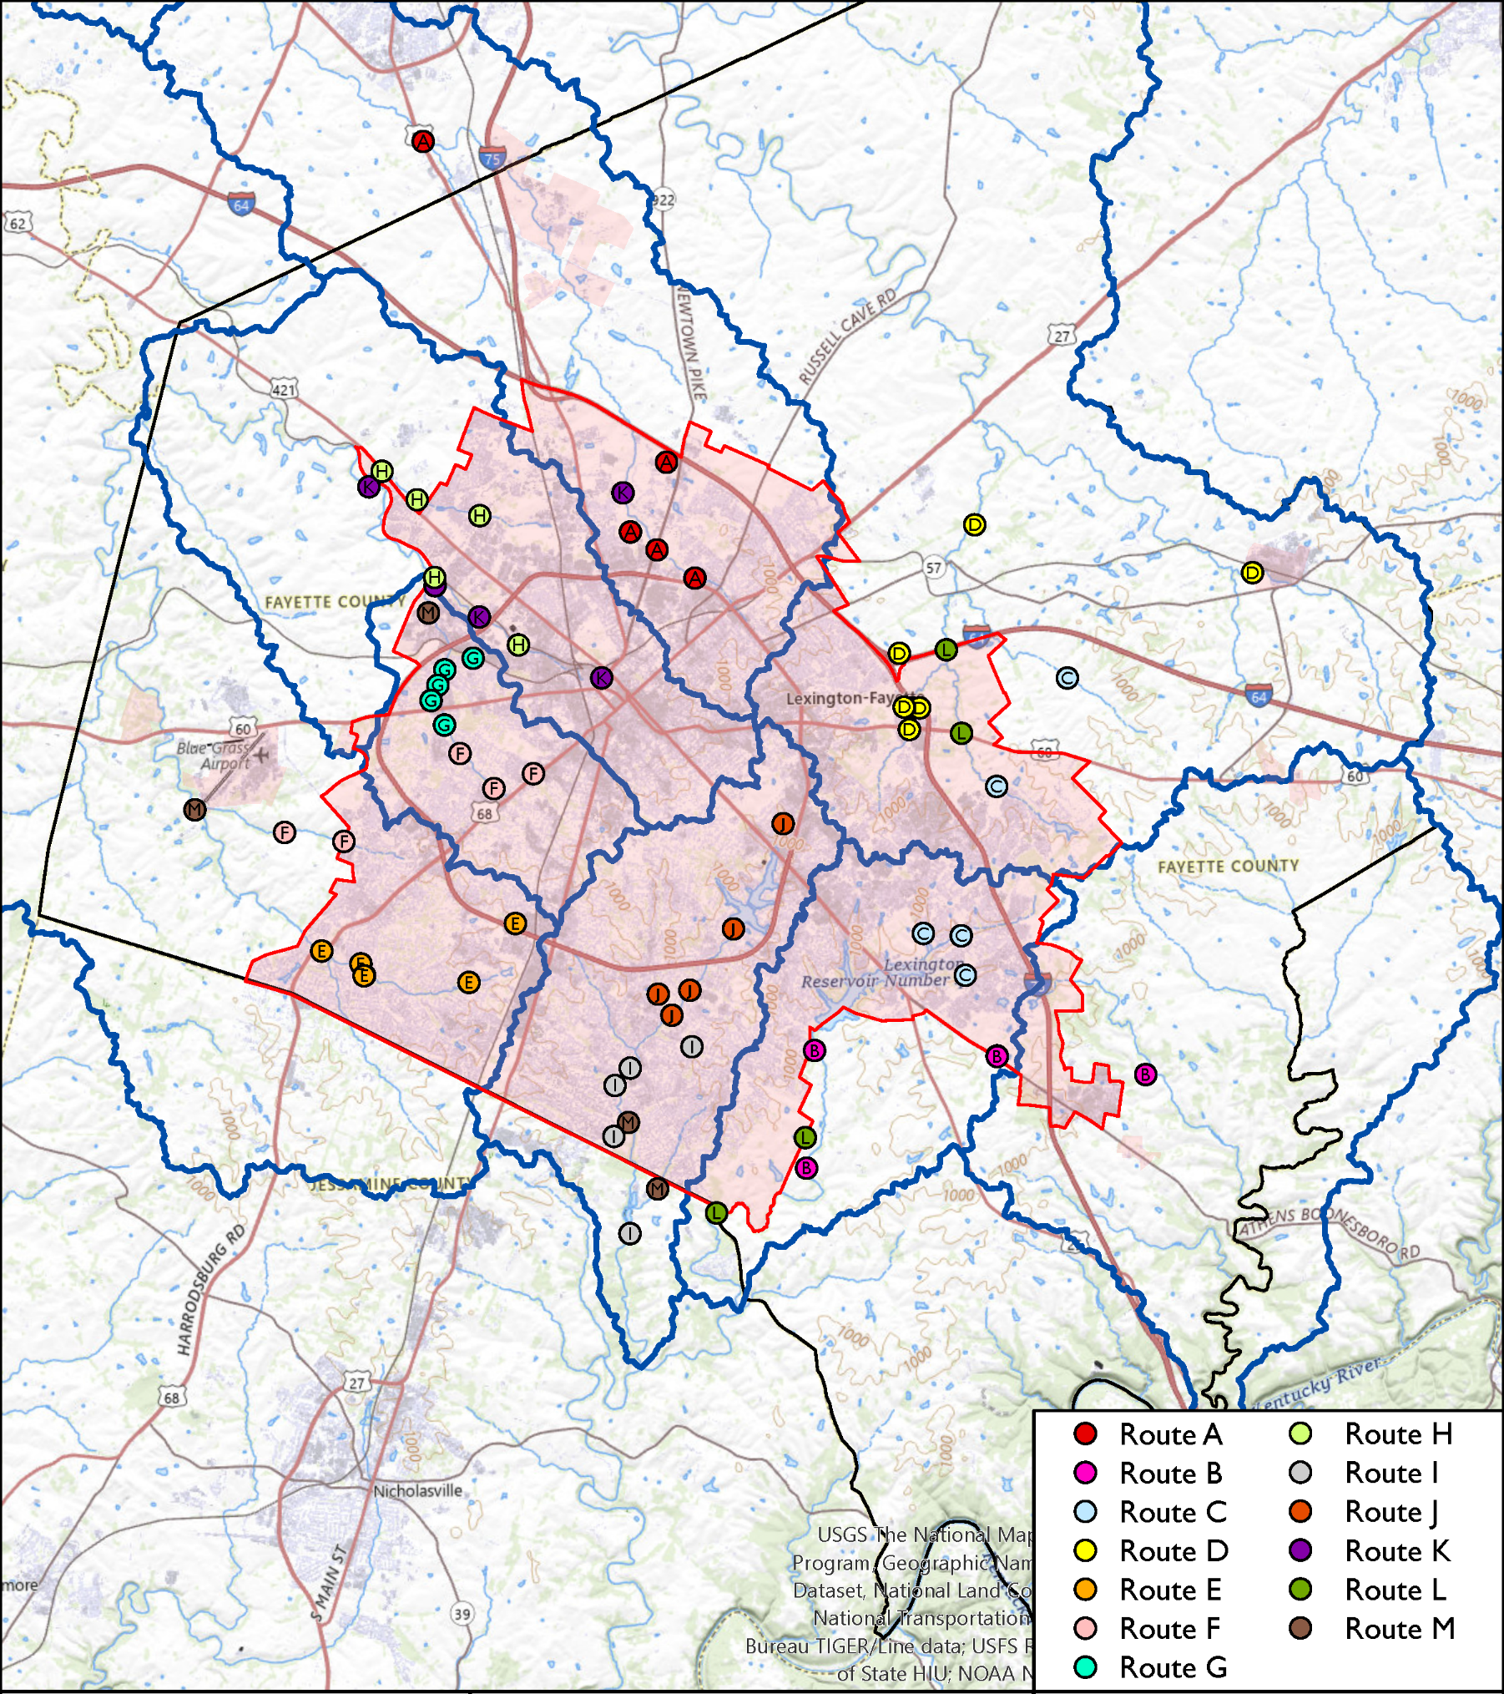
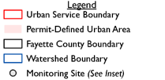
Scheduled Water Quality
Routes A thru M
LFUCG Stream Monitoring Program | Volunteer Training | Presented by Third Rock Consultants, LLC

Slide 6
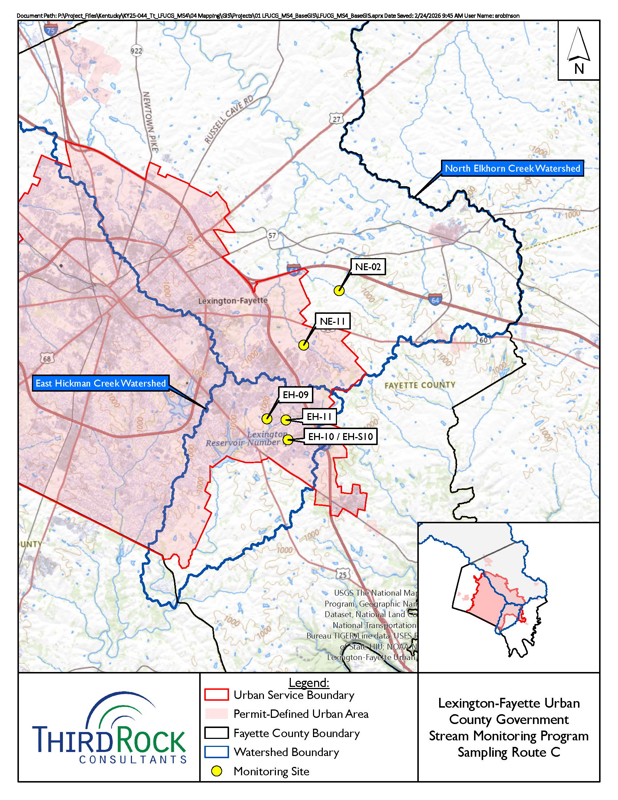
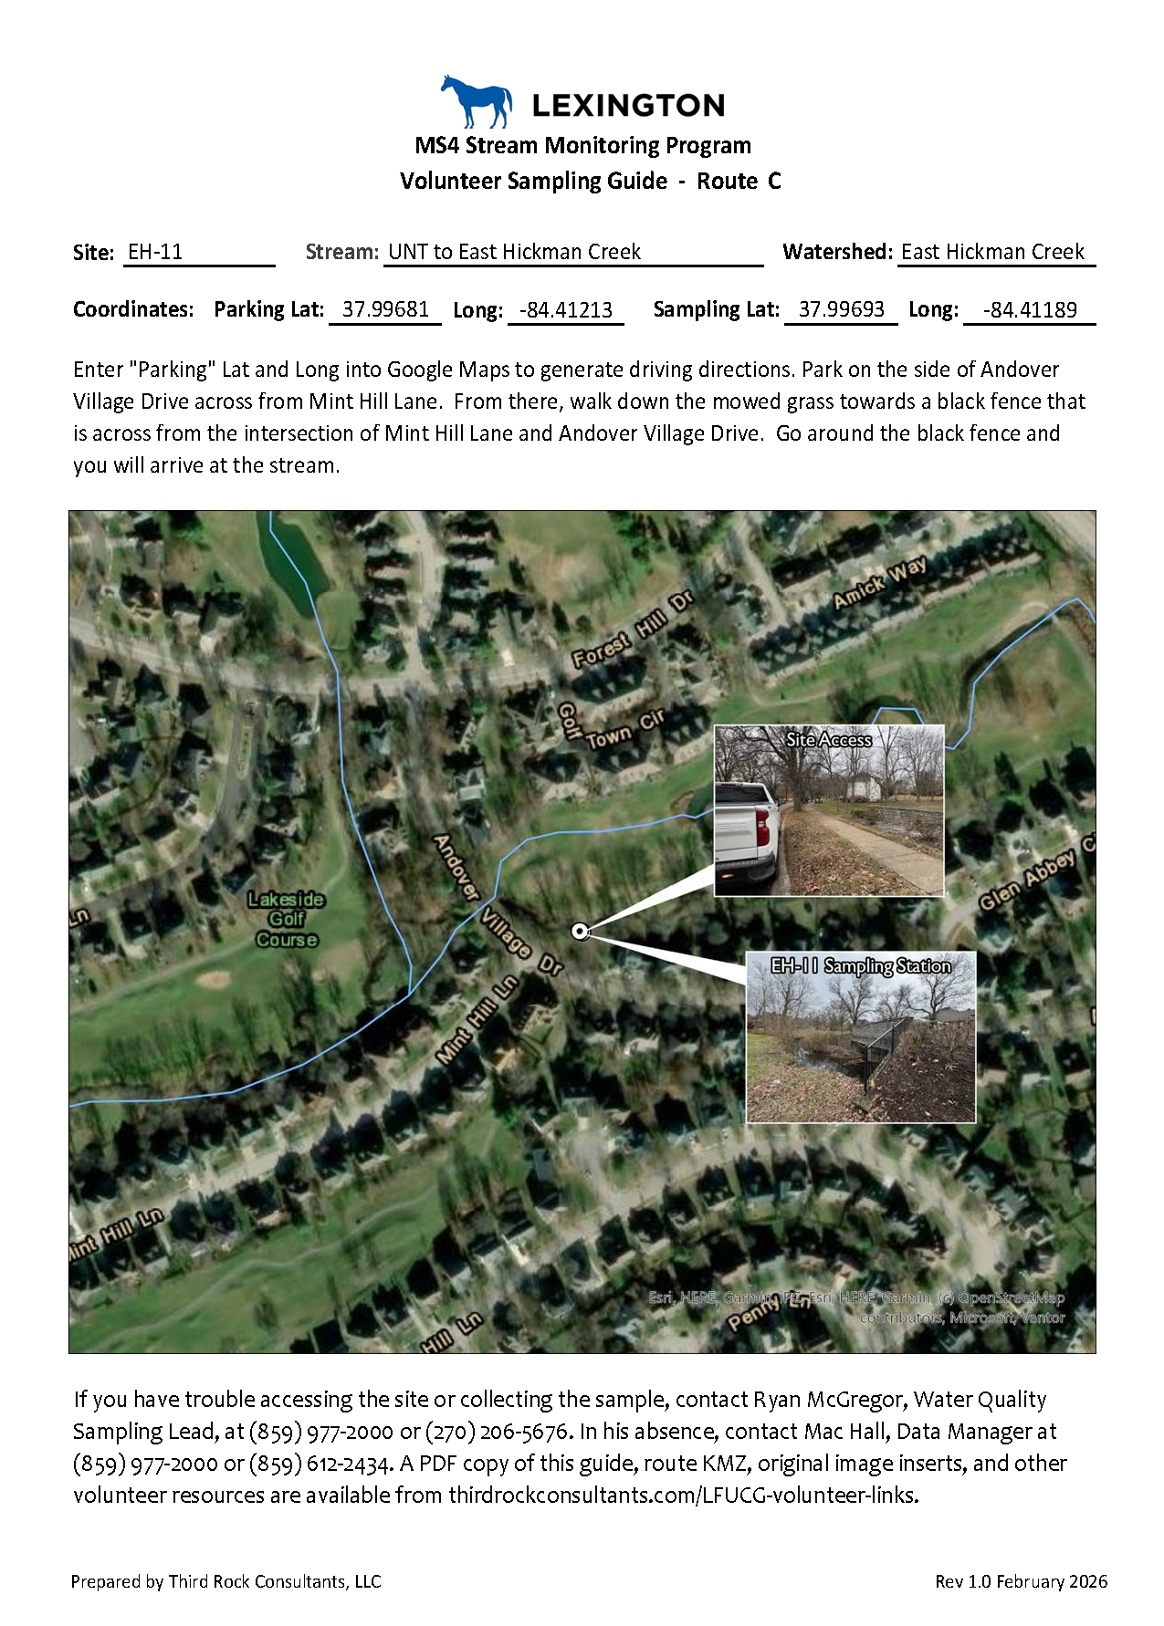
Example Route Map
Example Guide Sheet
LFUCG Stream Monitoring Program | Volunteer Training | Presented by Third Rock Consultants, LLC

Slide 7
  Water Quality Sampling Methods and Procedures
Grab samples will be collected and analyzed for total suspended solids, E. coli, total phosphorus, ammonia-nitrogen, total Kjeldahl nitrogen, nitrate-nitrogen, and nitrite-nitrogen
Dissolved oxygen, pH, temperature, and conductivity measurements collected in situ using a Hanna H198194 Multiparameter Meter
Chlorine will be measured using a Hanna T711 Total Chlorine Checker
Flow estimated using the recorded depth at the staff gauge
Field duplicate samples will be collected at a minimum of 10% of samples.
E. coli field blanks will be collected once per
team for each day of bacteria sample collection.
Field blanks for all other parameters will be
collected at a minimum of 10% of sites.
LFUCG Stream Monitoring Program | Volunteer Training | Presented by Third Rock Consultants, LLC

Slide 8
  Water Quality Sampling Methods and Procedures Cont.
Daily rinsate blanks will be measured for parameters or sampling methods requiring equipment rinsing between samples (e.g. chlorine using a Hanna Checker)
A Chain-of-Custody (COC) form will be completed for each route
Field observations will be recorded for each site on the reverse side of the COC.
A Field Duplicate Record will be completed for each site at which a field duplicate is collected.
LFUCG Stream Monitoring Program | Volunteer Training | Presented by Third Rock Consultants, LLC

Slide 9
Grab samples will be collected and analyzed for total suspended solids, E. coli, total phosphorus, ammonia-nitrogen, total Kjeldahl nitrogen, nitrate-nitrogen, and nitrite-nitrogen
  Sample in well-mixed reach, preferably downstream of riffle (do not disturb bottom sediment). Do not sample ponded water.
  Sample centroid of flow (not edge) at mid depth.
  Approach from downstream, point bottle upstream, and submerge
  Triple rinse unpreserved bottles with source water.
  Fill bottles that contain preservative directly from the source water, do not triple rinse. Be careful not to overfill. If overfilled, do not pour out extra. Laboratory will pipette out extra.
  Rinse bottle cap with water from stream prior to capping
  Place sample in large, plastic, locking bag.
  Place bagged sample on ice in cooler as soon as possible
LFUCG Stream Monitoring Program | Volunteer Training | Presented by Third Rock Consultants, LLC

Slide 10
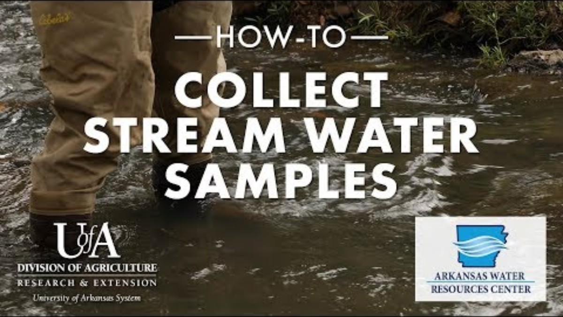
Click above to view video
LFUCG Stream Monitoring Program | Volunteer Training | Presented by Third Rock Consultants, LLC

Slide 11
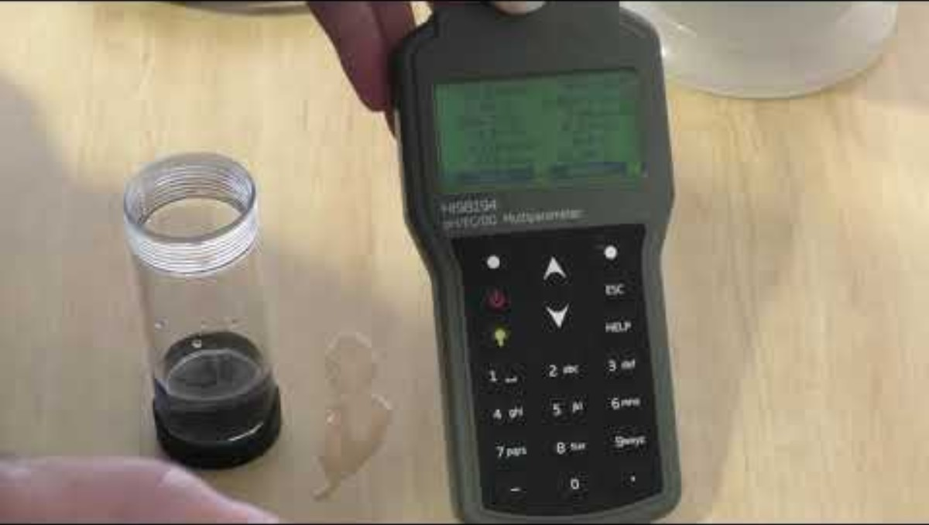
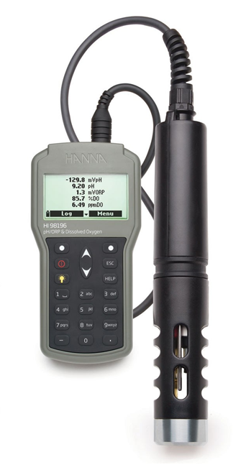
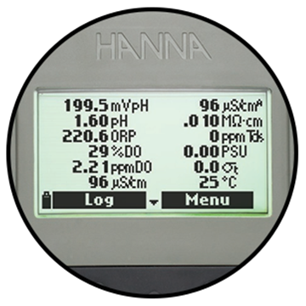
Dissolved oxygen, pH, temperature, and conductivity collected in situ using a Hanna H198194 Multiparameter Meter
Click above to view video
LFUCG Stream Monitoring Program | Volunteer Training | Presented by Third Rock Consultants, LLC

Slide 12

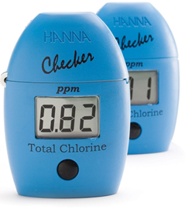
Chlorine will be measured using a Hanna T711 Total Chlorine Checker
  Analysis requires 2 minutes and 30 seconds.
  Beware of moisture / fingerprints outside / microbubbles inside.
  If you have an error, start over.
  Triple rinse vials with DI water between measurements.
Click above to view video
LFUCG Stream Monitoring Program | Volunteer Training | Presented by Third Rock Consultants, LLC

Slide 13
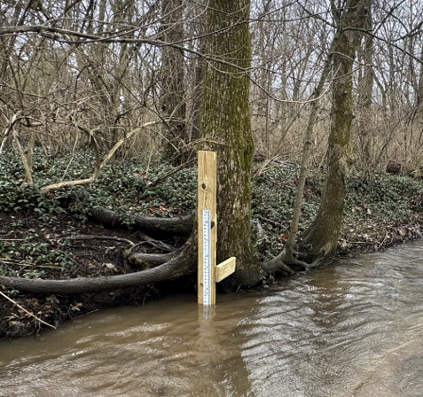
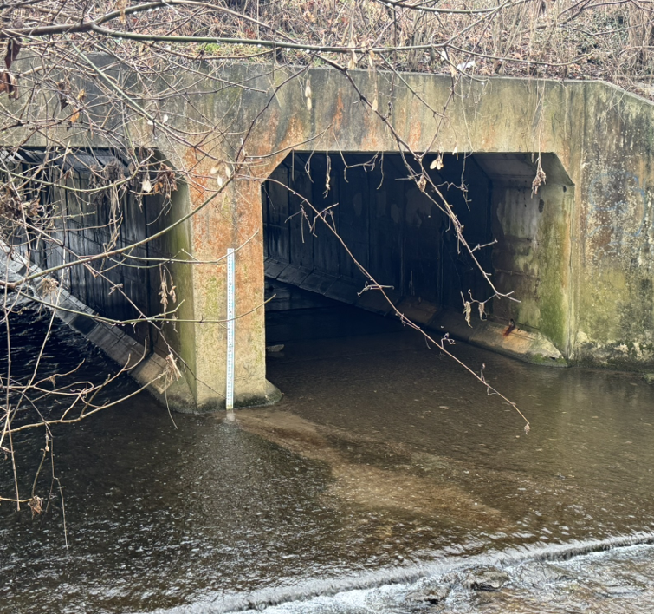
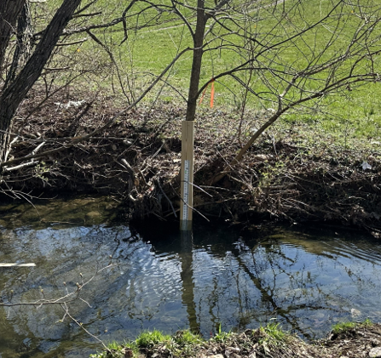
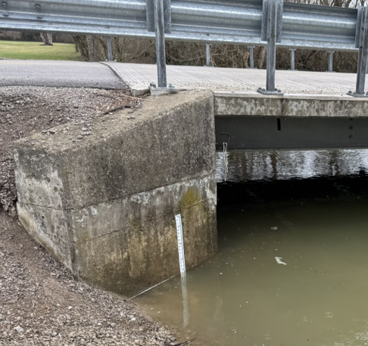
Flow will be estimated using the recorded depth at the staff gauge.
Staff gauges have been installed at each stream site.
LFUCG Stream Monitoring Program | Volunteer Training | Presented by Third Rock Consultants, LLC

Slide 14
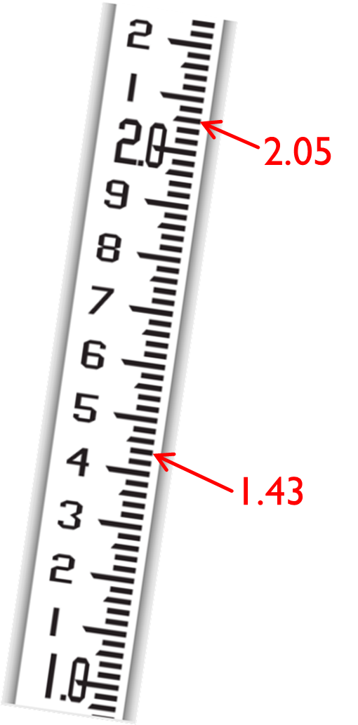
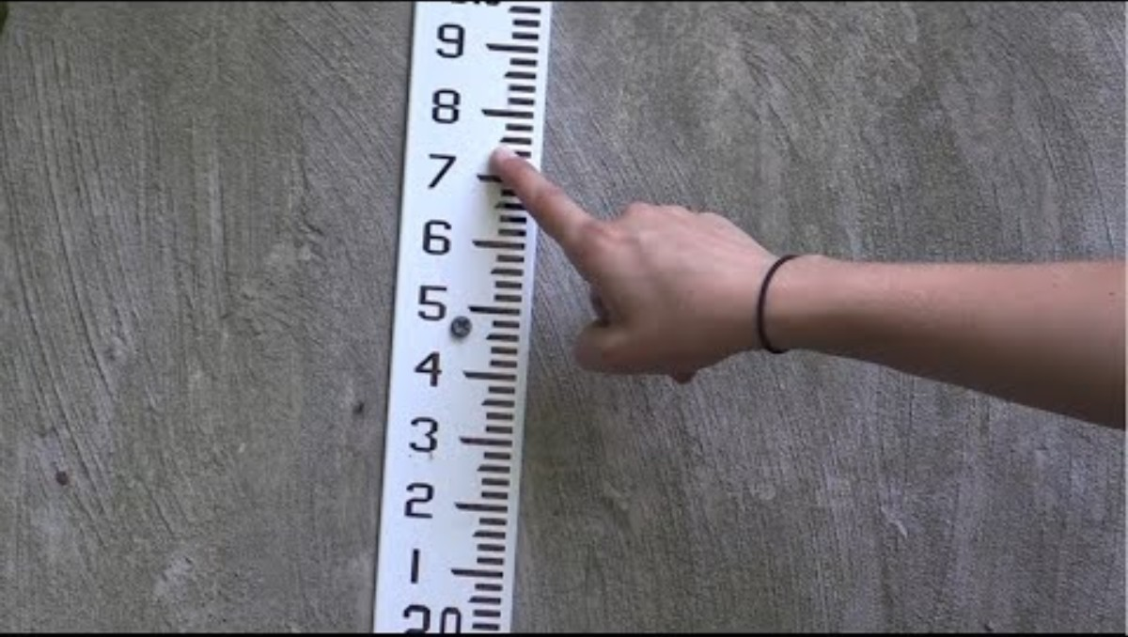
Record the depth to nearest hundredth of a foot. Gauge marks are 0.01 ft apart.
Feet and tenths are labeled numerically. Hash marks between the tenths measure hundredths.
Click above to view video
LFUCG Stream Monitoring Program | Volunteer Training | Presented by Third Rock Consultants, LLC

Slide 15
Field duplicate samples will be collected at a minimum of 10% of sites sampled.
If your route has been assigned to collect field duplicate samples, collect a second, identical sample at the same time and in the same location for handling and analysis in the same manner.
Record in situ measurements for the site on the Field Duplicate Record that is not submitted to the laboratory with the chain-of-custody form.
LFUCG Stream Monitoring Program | Volunteer Training | Presented by Third Rock Consultants, LLC

Slide 16
E. coli field blanks will be collected once per team for each day of bacteria sample collection. Field blanks for all other parameters will be collected at a minimum of 10% of sites.
  Each team will collect at a minimum one E. coli blank sample per day. If your route has been assigned to collect a field duplicate, you will also collect a field blank for all other parameters.
  Fill a second set of sample bottles labeled “Blank” with DI water. Blanks are not recorded for the multi parameter meters as DI water can damage the sensors.
For parameters or sampling methods requiring equipment rinsing between samples (e.g. chlorine using a Hanna Checker) daily rinsate blanks will be measured.
.
  Fill chlorine vile with DI water and measure chlorine. Record the measurement on the appropriate Field Blank line of the COC.
LFUCG Stream Monitoring Program | Volunteer Training | Presented by Third Rock Consultants, LLC

Slide 17
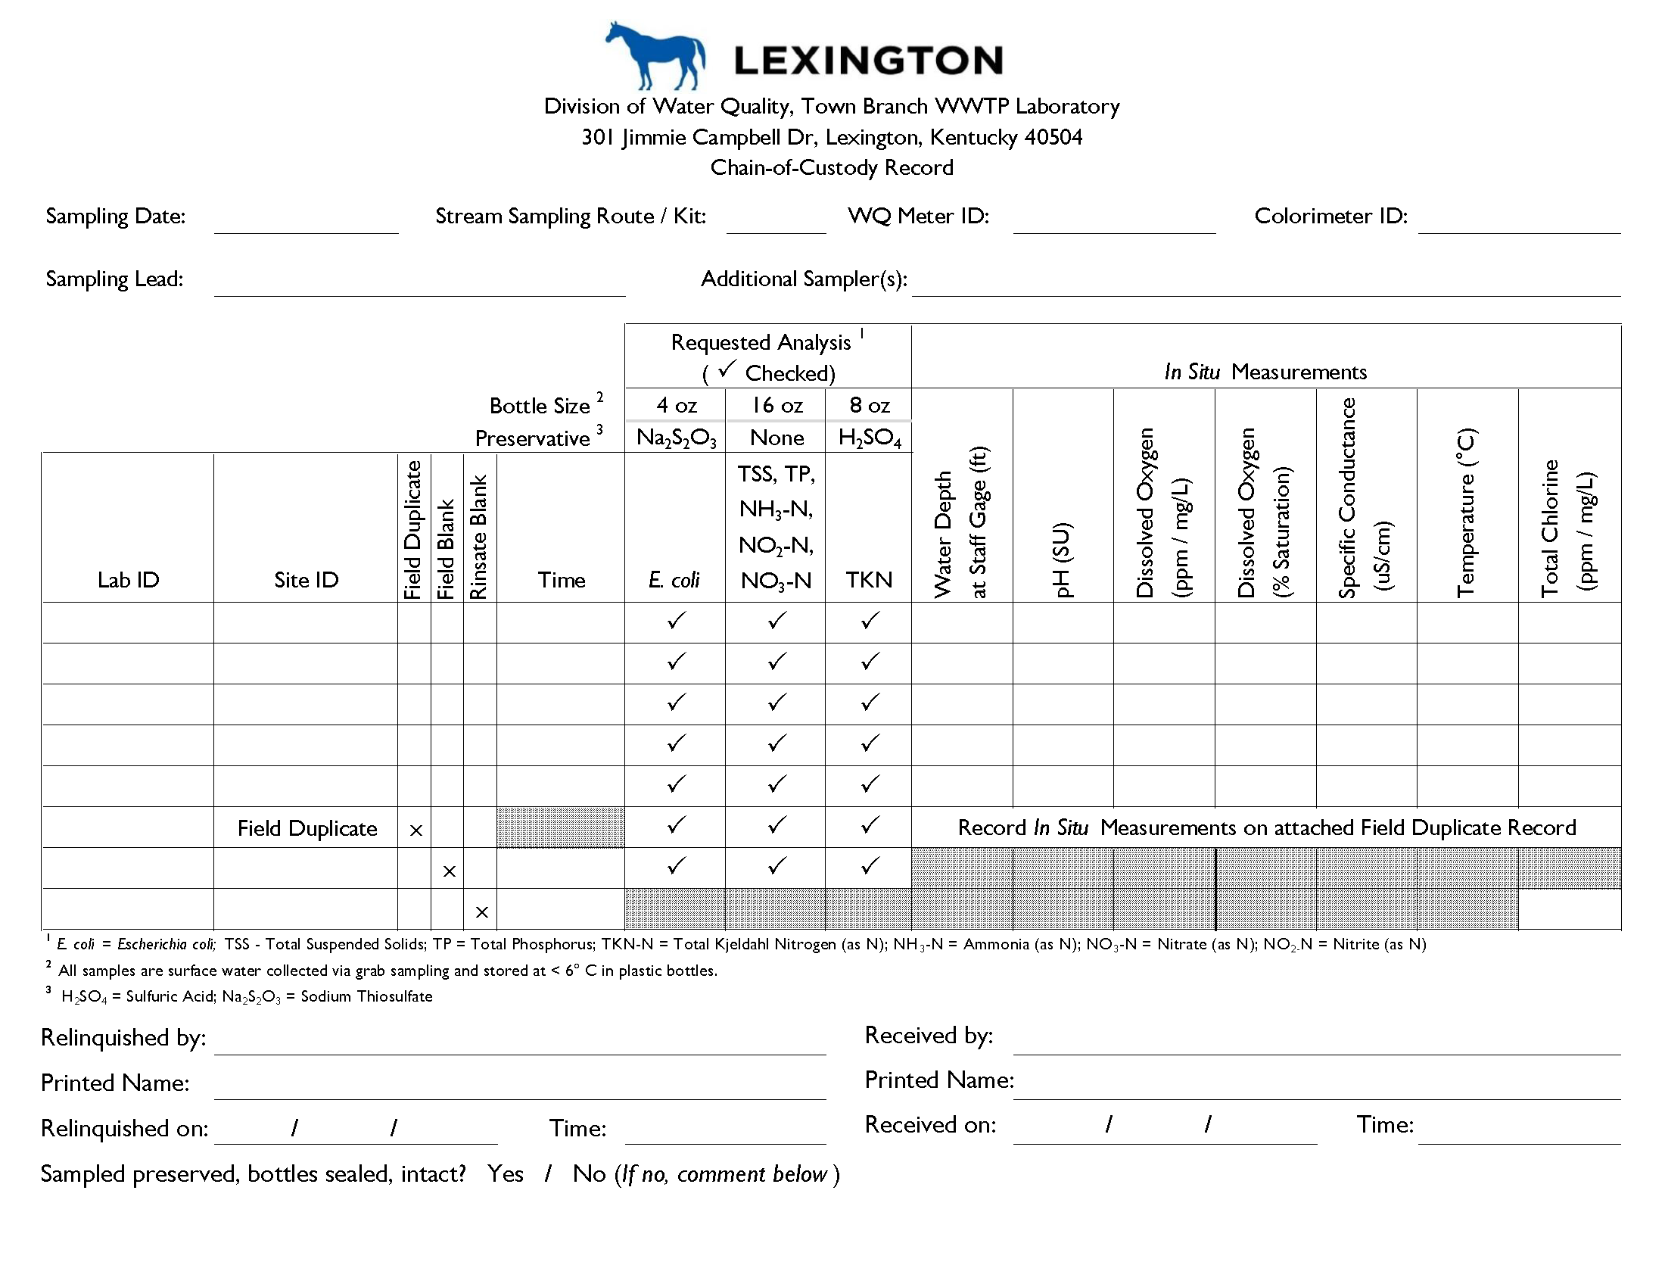
A Chain-of-Custody (COC) form will be completed for each route.
LFUCG Stream Monitoring Program | Volunteer Training | Presented by Third Rock Consultants, LLC

Slide 18
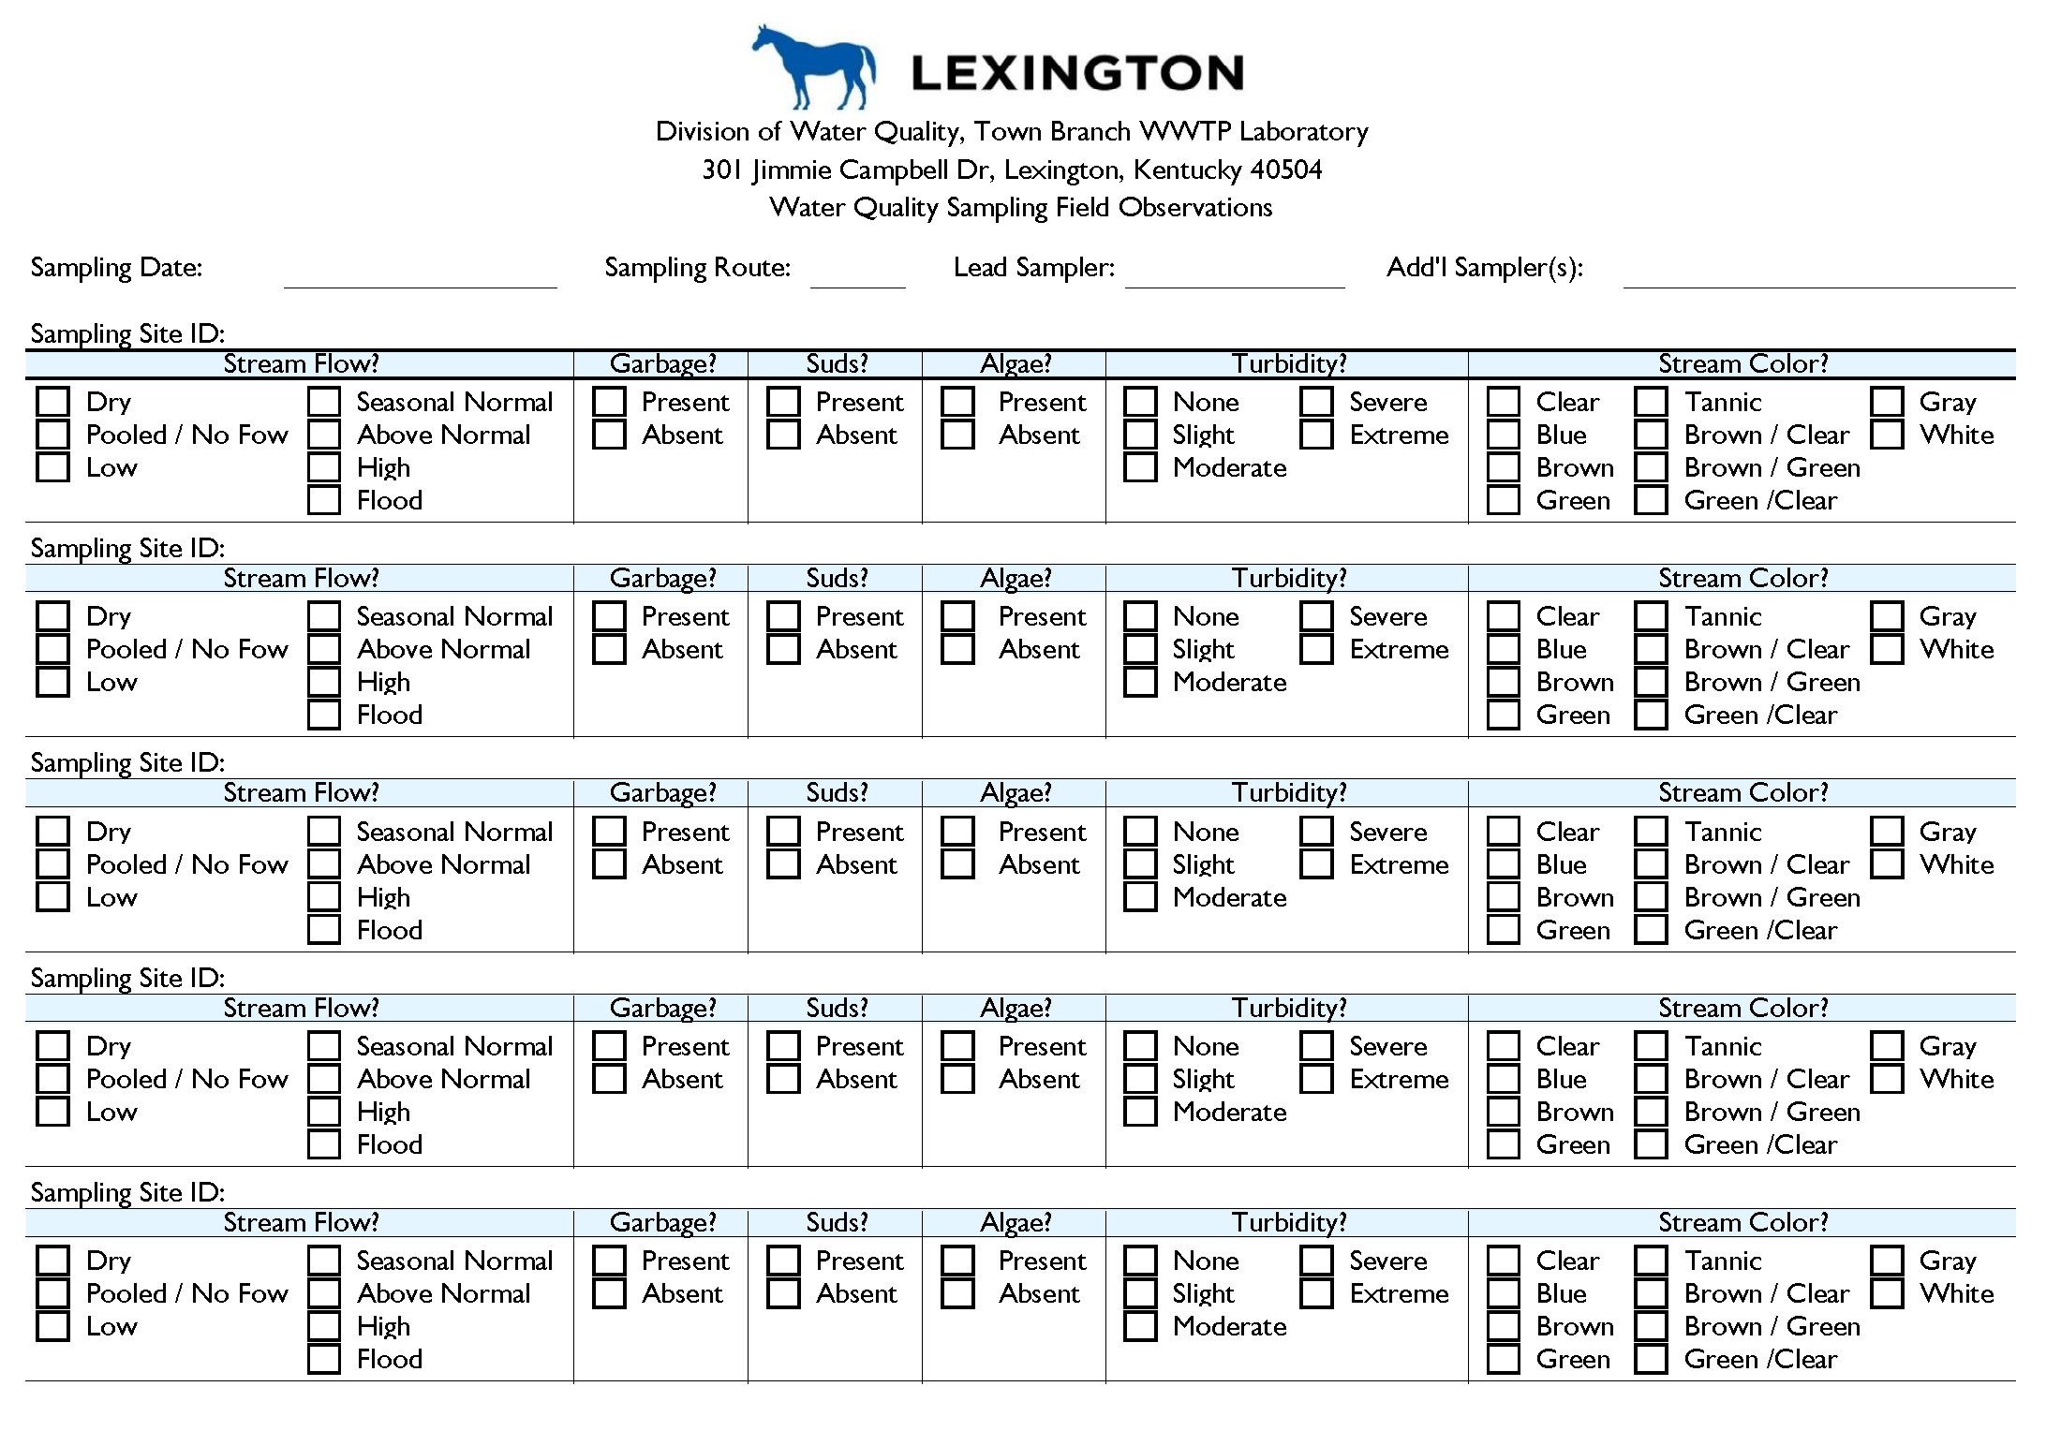
Field observations will be recorded for each site on the reverse side of the COC for the route.
LFUCG Stream Monitoring Program | Volunteer Training | Presented by Third Rock Consultants, LLC

Slide 19
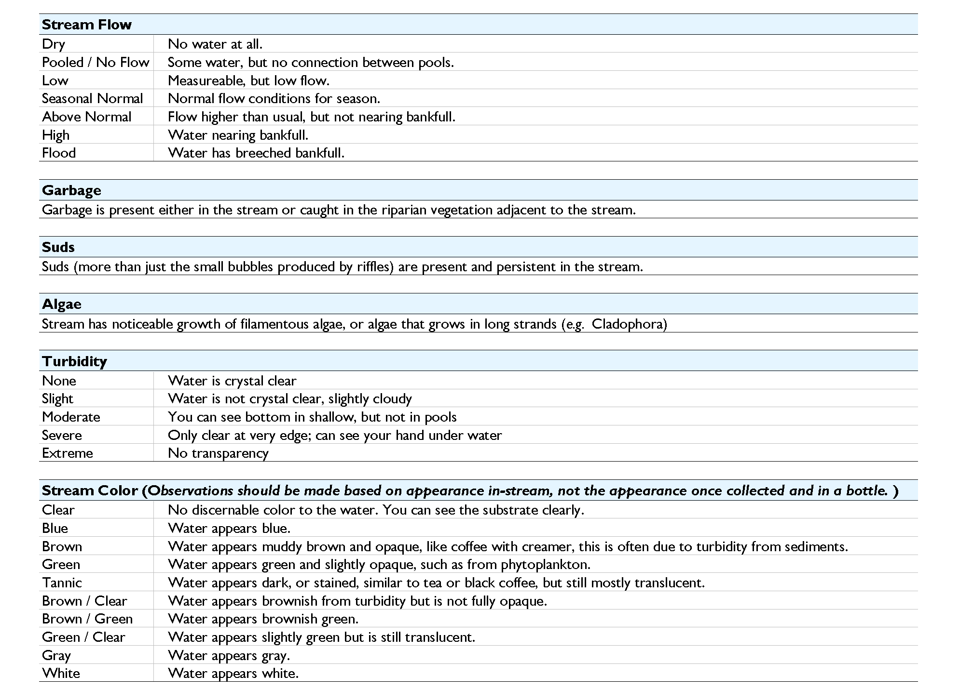
Field Observations - Definitions
LFUCG Stream Monitoring Program | Volunteer Training | Presented by Third Rock Consultants, LLC

Slide 20
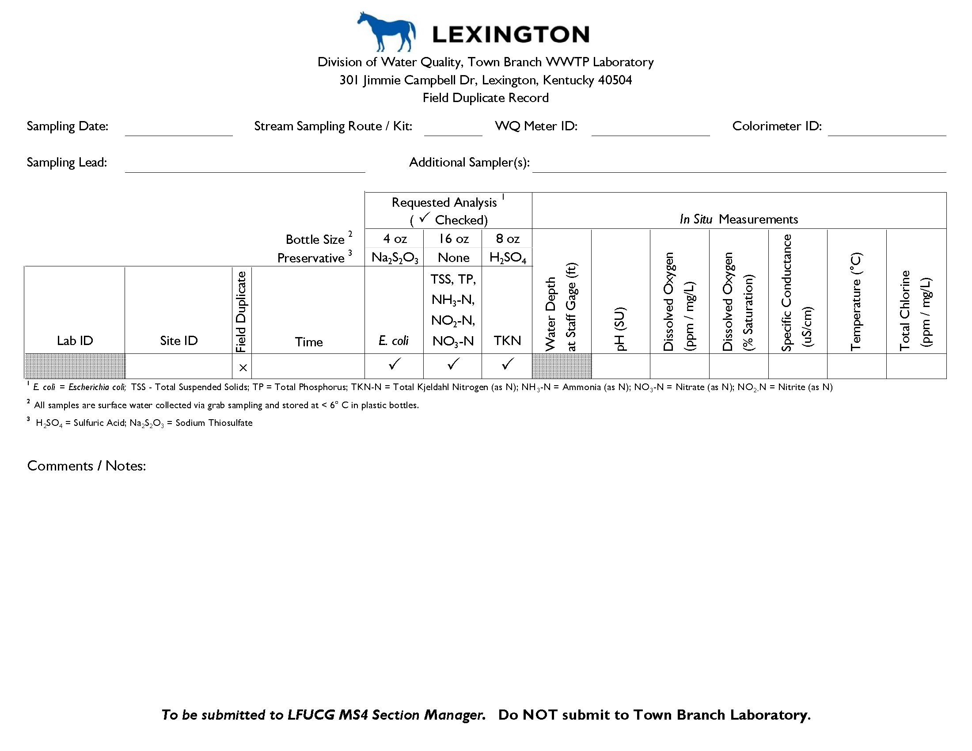
A Field Duplicate Record will be completed for each site at which a field duplicate is collected.
LFUCG Stream Monitoring Program | Volunteer Training | Presented by Third Rock Consultants, LLC

Slide 21
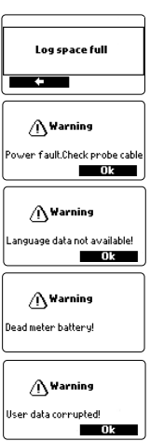
  Equipment Operation / Trouble Shooting
Hanna H198194 Multiparameter Meter
Turn on, press ESC if you don’t see measurements.
Press up or down to get all results. Wait to equilibrate and record measurements shown on the screen.
Warnings may appear as shown.
Any critical errors that appear are identified using a numeric code, and the meter will automatically switch off
If you encounter any warnings or errors, contact sampling lead and return meter to lab for replacement.
LFUCG Stream Monitoring Program | Volunteer Training | Presented by Third Rock Consultants, LLC

Slide 22
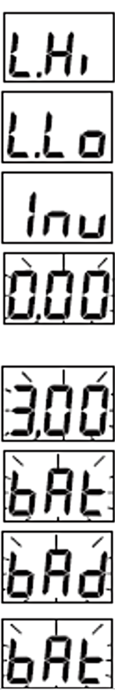
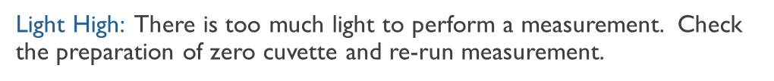

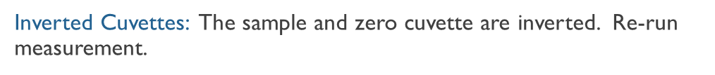
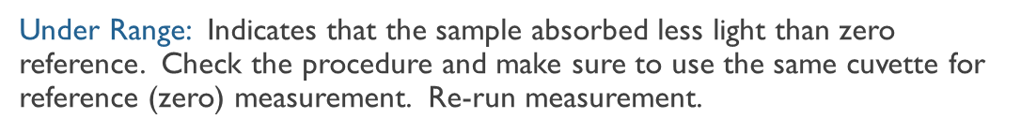
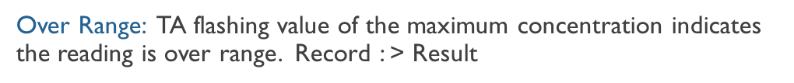
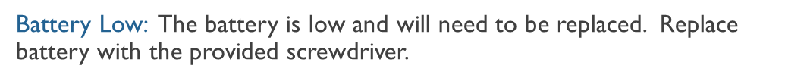
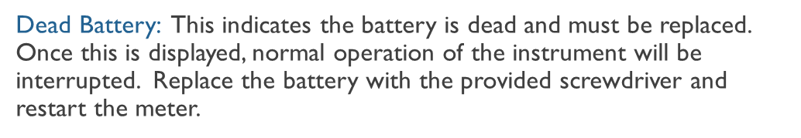
Hanna T711 Total Chlorine Checker
List of potential error messages shown below and included in handout
LFUCG Stream Monitoring Program | Volunteer Training | Presented by Third Rock Consultants, LLC

Slide 23
Questions / Discussion
LFUCG Stream Monitoring Program | Volunteer Training | Presented by Third Rock Consultants, LLC

